Slide 1
OCN 479-001: Smart Coasts
Week 7
Power Budget, Sensor specs, Metadata vs datadata

Slide 2

Power Budgeting
How do you figure out how long something will last in the field?
How much capacity you have/how much sensor(s) will draw

Slide 3
Budget concept
General:
Available = initial + additions – subtractions
Finance:
Balance = savings + earnings – expenditures
Power:
?

Slide 4
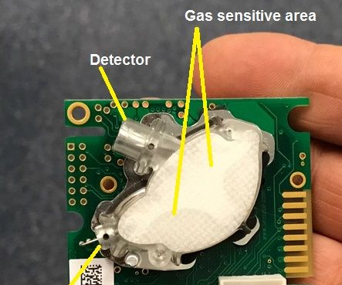
Example sensor:
SenseAir K-30, a low-cost indoor air quality CO2 sensor
https://www.instructables.com/Track-CO2-Carbon-Dioxide-Levels-With-Ardunio-and-C/

Slide 5
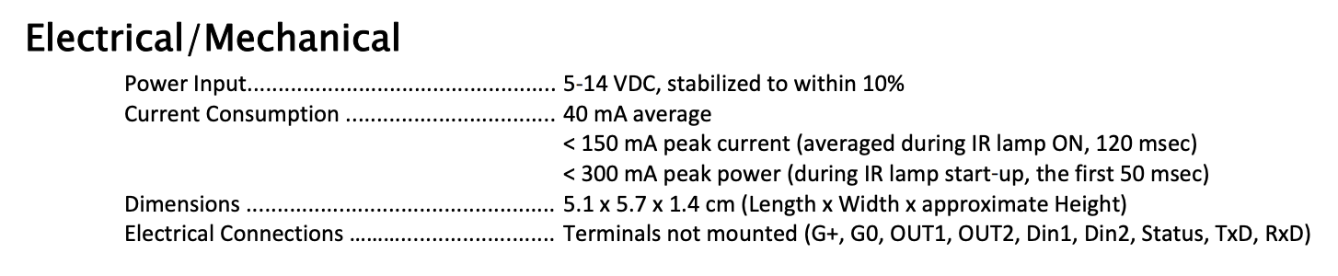
Power Budget for Sensor
Step 1: look up component datasheets, e.g.,

Slide 6
3.7 V “nominal”
Step 2: look up how much power you have, multiply A-h by V to get W-h
https://community.particle.io/t/can-argon-or-xenon-read-the-battery-state/45554/45?u=fragma
https://www.adafruit.com/product/258

Slide 7
Simple Estimate
We have 1200 mA*hr * 3.7 V = 4.44 W*hr
We will use > 40 mA * 5 V (for K-30; ignore microcontroller for now) = 200 mW = 0.2 W

Slide 8
Simple Estimate
We have 1200 mA*hr * 3.7 V = 4.44 W*hr
We will use > 40 mA * 5 V (for K-30; ignore microcontroller for now) = 200 mW = 0.2 W
So 4.44 W*hr/0.2 W = 22 hours

Slide 9
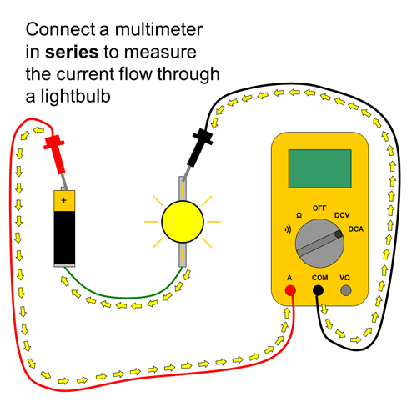
Taking it further: measure current in all states (e.g., sampling, sleeping, publishing)
https://www.sciencebuddies.org/science-fair-projects/references/how-to-use-a-multimeter

Slide 10
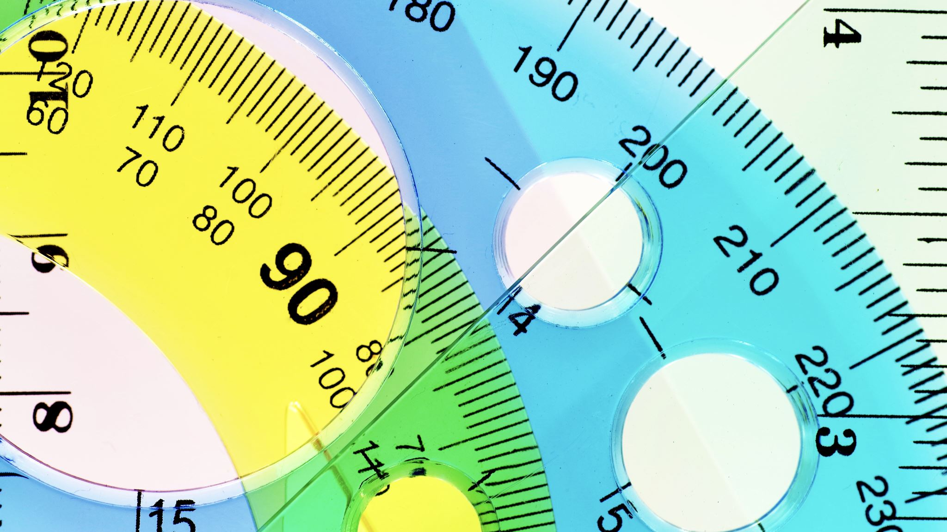
Sensor Specifications

Slide 11
Important Metrics
Match a letter from the left to the following:
Accurate but imprecise
Precise but inaccurate
Imprecise and inaccurate
Precise and accurate

Slide 12
Important Metrics
Match a letter from the left to the following:
Accurate but imprecise
Precise but inaccurate
Imprecise and inaccurate
Precise and accurate
C

Slide 13
Important Metrics
Match a letter from the left to the following:
Accurate but imprecise
Precise but inaccurate
Imprecise and inaccurate
Precise and accurate
C
B

Slide 14
Important Metrics
Match a letter from the left to the following:
Accurate but imprecise
Precise but inaccurate
Imprecise and inaccurate
Precise and accurate
C
B
A
D

Slide 15
Important Metrics
Example: ”true” temperature is 100 ºC
Take 10 samples. Get average and stdev (report as average±stdev)
Accurate but imprecise: thermometer measures 100.1±36 ºC
Inaccurate but precise: thermometer measures 56±0.2 ºC
Inaccurate, imprecise: 56±36 ºF
Accurate, precise: 100.1±0.2 ºC

Slide 16
Important Metrics
Extremely important: “accuracy” and “precision” are relative terms. Values ascribed to them depends on application!
Example: ”true” temperature is 100 ºF
Take 10 samples. Get average and stdev (report as average±stdev)
Accurate but imprecise: thermometer measures 100.1±36 ºC
Inaccurate but precise: thermometer measures 56±0.2 ºC
Inaccurate, imprecise: 56±36 ºF
Accurate, precise: 100.1±0.2 ºC

Slide 17
Important Metrics
Accuracy, precision
https://manoa.hawaii.edu/exploringourfluidearth/physical/world-ocean/map-distortion/practices-science-precision-vs-accuracy

Slide 18
Important Metrics
Accuracy, precision, stability
Continuing previous example:
Actual temperature not changing, but measurements are:
t = 0 min, T = 99.8±0.2 ºC
t = 10 min, T = 101.4±0.1 ºC
t = 20 min, T = 103.7±0.2 ºC
t = 0 min
t = 10 min
t = 20 min
https://manoa.hawaii.edu/exploringourfluidearth/physical/world-ocean/map-distortion/practices-science-precision-vs-accuracy

Slide 19
Important Metrics
Accuracy, precision, stability, resolution
Does your thermometer tell you temperature to 1 degree? 0.1? 0.01?
Just because there are more decimal points (higher resolution) does not mean it is more accurate!
https://www.allsensors.com/engineering-resources/white-papers/accuracy-and-precision-for-mems-pressure-sensors

Slide 20
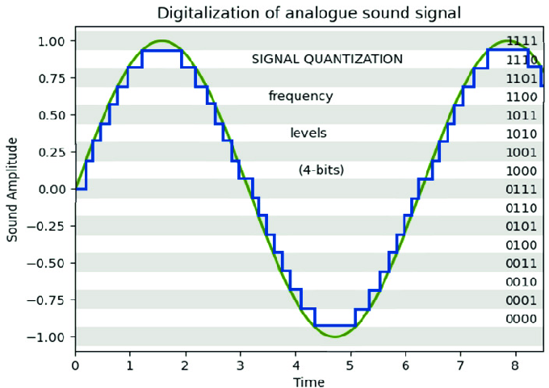
Important Metrics
Accuracy, precision, stability, resolution
Does your thermometer tell you temperature to 1 degree? 0.1? 0.01?
Just because there are more decimal points (higher resolution) does not mean it is more accurate!
https://www.researchgate.net/figure/Quantization-resolution-in-this-example-is-4_fig2_352898102

Slide 21
Important Metrics
Accuracy/precision/stability/resolution
Response time (imagine you move a thermometer from an icewater bucket to a pot of boiling water; how long will it take for the thermometer to change temps?)
https://blog.wika.us/products/temperature-products/temperature-sensors-thermowells-and-response-times/

Slide 22
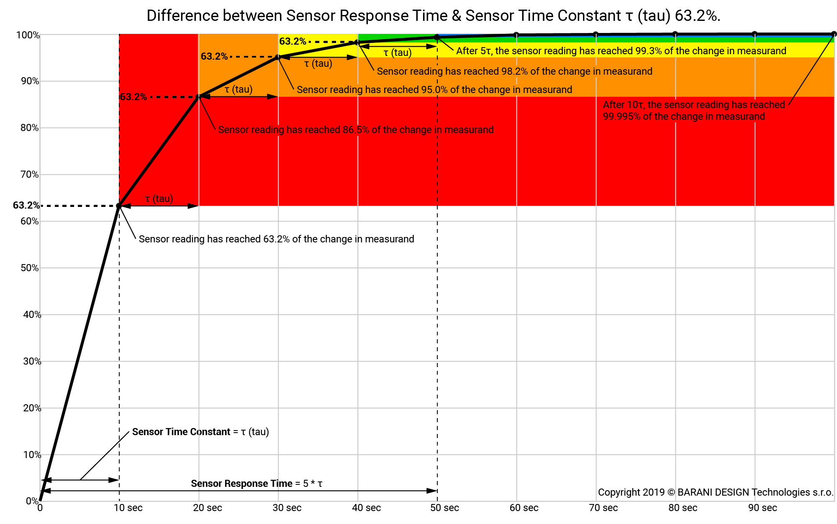
Response time defined
https://www.baranidesign.com/faq-articles/2019/5/6/difference-between-sensor-response-time-and-sensor-time-constant-tau

Slide 23
Available technologies
Which value do sensor manufacturers use? (Whatever they want—zero consistency in this arena)
If your project requires accuracy, precision, stability, response time, etc., VERIFY for yourself
Some manufacturers very honest & thorough results, some report “best case scenario” or results of one specific, narrowly defined test

Slide 24
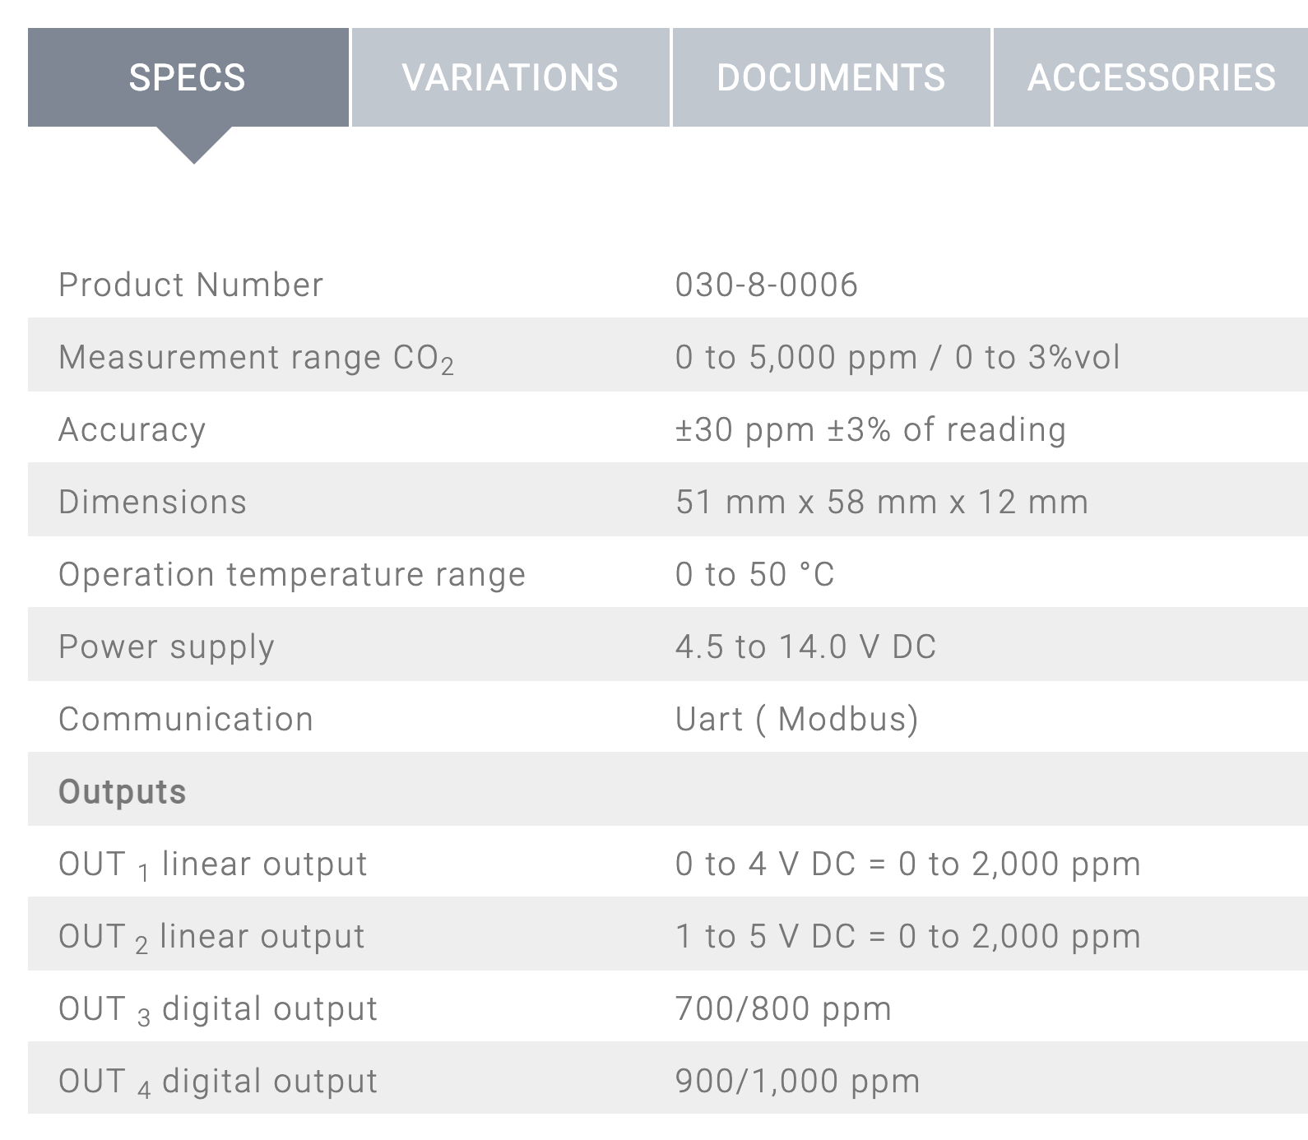
Spec sheet example
What is accuracy @ current atmospheric CO2?
Just because it works over a range of temp, pressure, salinity, etc. doesn’t mean it performs the same!

Slide 25
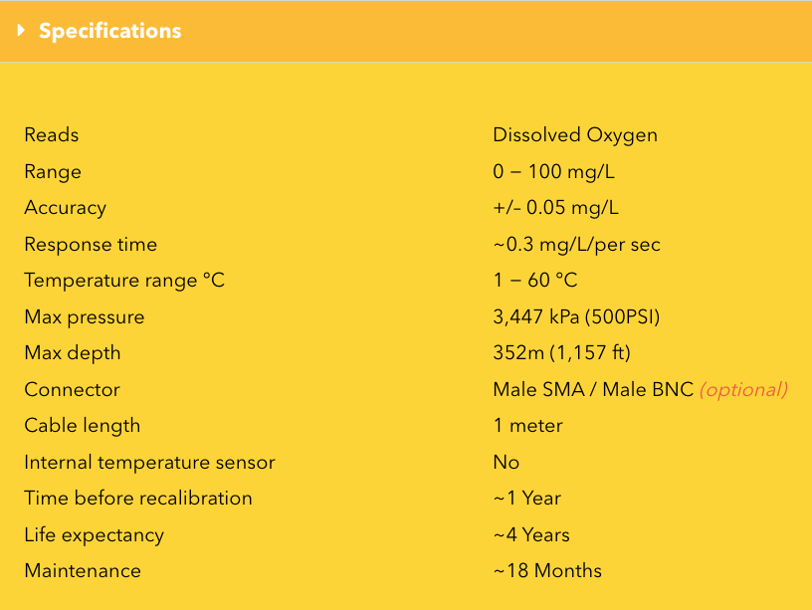
Spec sheet example

Slide 26
Data and Metadata

Slide 27
Data vs. Metadata
Data:
A measurement (from a sensor, analyzer, a ruler, etc.)
Observations, including numbers and words

Slide 28
Data vs. Metadata
Data:
A measurement (from a sensor, analyzer, a ruler, etc.)
Observations, including numbers and words
Metadata
Data about the data
How were data collected?
What was the instrument?
When was it last calibrated?
What are its calibration coefficients?
Who made the measurement?

Slide 29
Why?
Research is meant to be reproducible
By you
By anyone who reads your paper, lab notebook, etc.
You’ll remember very little of your past work after weeks/months/years

Slide 30
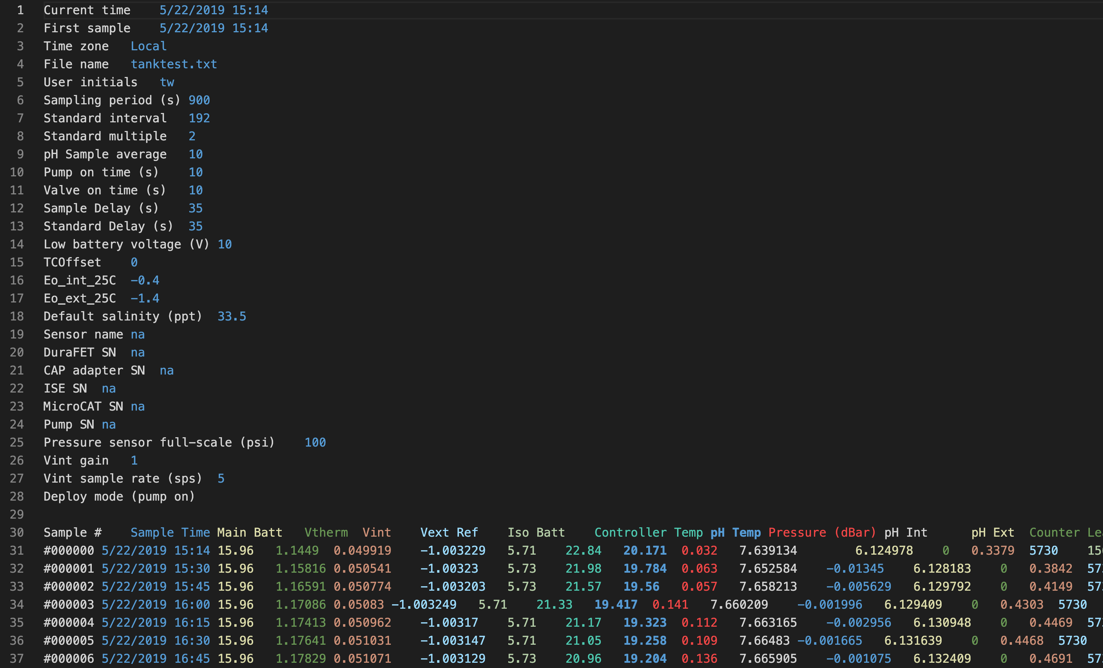

Slide 31
METADATA
COLUMN HEADERS
DATA

